Slide 1
Feeling with Intention
October 15, 2017
Living with Intention

Slide 2
Interior Experience - Feelings
What is powerfully immediate for you that no one else knows until you choose to act in a way that informs them? Those are your interior experiences.
Are they real? Do they matter? Are they of value to you? Are they of value to others?
Feelings are a source of both information and energy. They tell us what is going on and they give us the motivation to act.
We don’t choose what we feel so much as whether we feel. We can be aware or we can be numb.

Slide 3
Distinctions
Emotion and Affect
Emotionality and Rationality
Reactive and Responsive

Slide 4
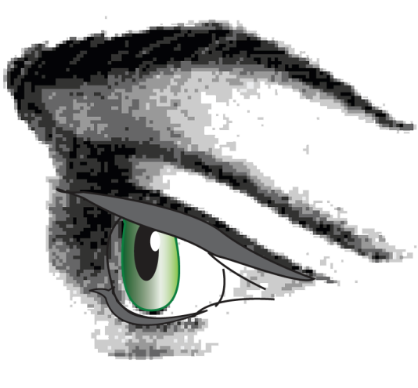
Aspects of awareness
Focus of attention: what I look at
Locus of Identity: where I look from
Lens or map: what I look through

Slide 5
Perspectives
When I focus my attention on a given object from a specific locus and look through a particular lens or with a particular map I am adopting a perspective.

Slide 6
Why we try not to feel our feelings
We don’t want to feel bad
We think there is a choice to feel good or to feel bad.
The choice is in how we will act and what we will pay attention to. Choosing not to pay attention to “bad” feelings:
Doesn’t make them go away.
Doesn’t mean we are not affected by them.
Doesn’t mean they don’t affect our behavior.

Slide 7
Four basic types of feelings
Sensation
Emotion
Thought
Wish

Slide 8
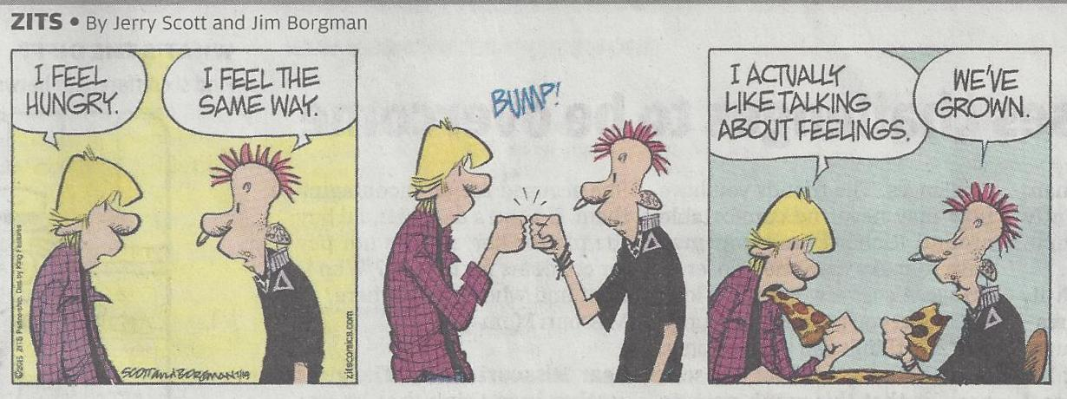

Slide 9
Domains of Consciousness
Sensations
Emotions
Thoughts
Wishes
Intuition
Imagination

Slide 10
The Five “Bad” Feelings
Hurt: the central bad feeling. I am not getting what I need. I am getting what I don’t need.
Fear: future tense hurt. This is going to hurt.
Sadness: past tense hurt. It really hurt when my Grandpa died.
Anger: the choice that the other makes hurts me.
Guilt: the choice that I make hurts another.

Slide 11
FEAR
ANGER
HURT
GUILT
SADNESS
Notes:
Layout of the five bad feelings spatially

Slide 12
Three tasks for building emotional competence
Naming:
Resolving:
What is this feeling?
What is this feeling about?
What can I do with the energy of the feeling to transform my experience?
What are all the feelings arising for me? How many aspects or dimensions of this experience can I name?
Addressing:
Can I learn from the data and harness the energy such that I can do something creative with this experience?
Is the feeling proportional to the event? Is it too big for what is happening or too small?
Does it remind me of past events?
Where does this feeling come from?
Notes:
Naming: What is this feeling?
Addressing : What is this feeling about? Where does it come from?
Resolving: How can I use the energy of the feeling to transform my experience?

Slide 13
Trauma
A circumstance in which we are stuck or torn
…and which we are not able to resolve when it arises
Results in a burdened part that carries an emotional charge
…which gets “triggered” when events with a similar emotional frequency arise.

Slide 14
Do you want to know what you are feeling?
Which feeling do you most not want to feel?

Slide 15
Bothers Me Log
We are urged to “not let things bother us”
We can’t address a problem until we become aware of it.
This discipline is about becoming aware of problems we already know how to solve but don’t.
The only true mistake is to not pay attention.

Slide 16
Bothers Me Log
Spend five minutes every day writing down what is bothering you or has bothered you in the last 24 hours.
Not a journal or a diary but a list
As a pattern emerges you may want to create a check list. “Has this bothered me in the last day?”

Slide 17
Anger Workout
Remember a time you made a choice you regret.
What emotions were you having in the moments just before you made that choice?
When you focus your attention now on the sensations and emotions you were having then, what happens?

Slide 18
Anger Workout
Set aside at least five minutes every day to focus your attention on the sensations and emotions you least like having.
Don’t replay events. Don’t make plans. Just feel your feelings.
Be safe. Don’t be with those who arouse these feelings or those who may be frightened by these feelings.
Don’t rehearse violence.

